Slide 1
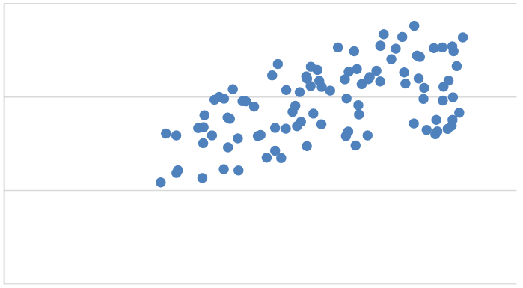
Regression
Use independent variables (x) to predict the value of a dependent variable (y)
“Simple regression” uses only one independent variable
Mathematical model: , plus error
Error (or residual): How far off was our estimate?
Minimize the sum of squared errors
y
x

Slide 2
Regression in Excel
Data Analysis add-in
Example: use the “Camry” file
Use regression to assess, for used Camrys, the relationship between the number of miles driven and the sale price
What sale price should we predict for a Camry with 60,000 miles?

Slide 3
Excel Output
Percentage of variation in the dependent variable explained by the independent variable, also called coefficient of determination
Standard error of a prediction (similar to standard deviation)
P-values indicating the significance of the model and the independent variable
Estimates of β₀ and β₁, respectively

Slide 4
Multiple Regression
More than one independent variable (plus error)
Concept is the same as simple linear regression
Software will find the set of β’s that minimizes the total squared errors
Can plug in values for x’s to get a prediction for y

Slide 5
Multiple Regression in Excel
Data Analysis add-in
Example: use the “BeachFrontHotels” file
The scores represent the percentages of survey respondents who rated the hotel as “excellent” or “very good”
Use regression to predict a hotel’s overall score based on the three individual scores for Comfort, Amenities, and In-House Dining

Slide 6
Excel Output
Percentage of variation in the dependent variable explained by the independent variable
R square, but adjusted for number of variables, to compare different regression models
Standard error of a prediction (similar to standard deviation)
Coefficients of the regression equation
Significance of the entire model
Significance of the individual independent variables

Slide 7
Regression in R
See Regression.R script
The “lm” function is native to R
We can use to it make predictions for new data points using the “predict” function

Slide 8
Qualitative Variables
Regression was intended for numeric variables
As X₁, X₂, etc. change, how does Y change?
What about qualitative data?
Qualitative independent variables can be handled via dummy variables (also called indicator variables)

Slide 9
Binary Variables
Easy to handle when the qualitative variable is binary
Yes/No, High/Low, Weekday/Weekend, etc.
Assign one category a value of 0, and the other a value of 1
They are then treated just like any other independent variable

Slide 10
Example
“Deliveries” file
Data used to predict a driver’s overall travel time (in hours)
The RushHour variable specifies whether a driver had to travel on the beltway during rush hour
Run the regression model, and interpret the coefficient on RushHour

Slide 11
Dummy Variables
What if the variable has more than two possible values?
Create a 0/1 dummy variable for each value
If the possible values are “red,” “yellow,” and “green,” create a dummy variable for each of the three colors
Then, e.g., the “red” dummy variable is 1 if that data point is red, and 0 otherwise
For every data point, exactly one of the dummy variables will have a value of 1

Slide 12
Dummy Variables
In regression, one of the dummy variables in the set must be omitted from the model
The last dummy variable in the set is redundant; it provides no information
That omitted value is treated as the base case (the “default” value)

Slide 13
Dummy Variables
To create dummy variables in Excel:
Use IF statements, e.g. “=IF(A2=“red”,1,0)”
To create dummy variables in R:
See DummyVariables.R
Several ways to do it

Slide 14
Example
The “CoffeeShops” file shows daily sales for franchises of a chain of coffee shops
The two independent variables are Temperature and Type (Full/InStore/Mobile)
First, create dummy variables for Type
Then, run the regression model
Try it in Excel or R (or both)

Slide 15
Forecasting with Regression
Regression can capture (additive) seasonality using a set of dummy variables
It can capture a linear trend if we include a “time” variable that orders the data points
Here’s what that would look like for data on call center volume:

Slide 16
Forecast with Regression?
Pro: Can incorporate additional independent variables (besides time)
Pro: More software options
Con: Can’t easily capture non-constant trends or seasonal effects
Con: Computationally more intensive if we’re going to forecast many periods

Slide 17
Interactions
Regression treats the effects of each independent variable as independent (!) of one another
Often a reasonable assumption
However, it ignores any synergistic (or anti-synergistic) effects between variables
Example: What do you think the relationship is between credit card debt (Y) and: IQ (X₁), income (X₂)

Slide 18
Interactions: Dummy Variable
Dummy variables shift the regression line up or down, but do not change the slope
A basic multiple regression model with dummy variables cannot capture relationships between temperature and sales that differ by store type

Slide 19
Optional: Capturing Interactions
To include interaction between X₁ and X₂ in the model, create a new variable whose value is X₁*X₂
In Excel, it would be a new column
In R, the lm function can include interaction terms; they do not need to be added to the dataset
See Regression.R script

Slide 20
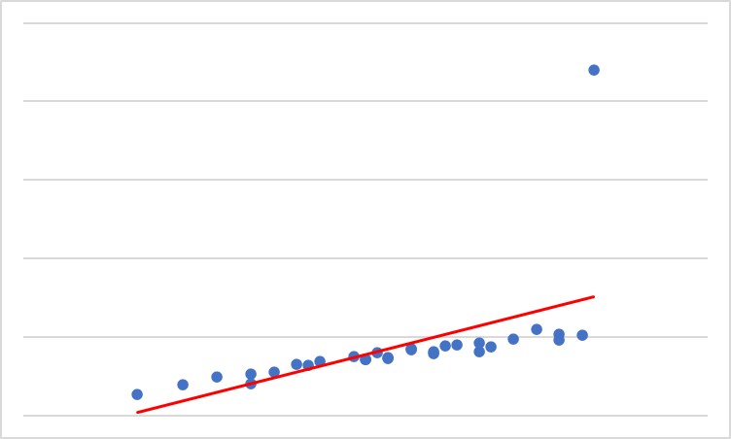
Shortcomings of Regression
Captures additive linear effects of variables
Can expand somewhat, but crudely
“Parametric”
Uses a mathematical model with implicit assumptions of how variables relate to one another
Prone to mistakes with a very large number of variables
Sensitive to outliers

